Slide 1

From data science to business
Product or Services development
Strategies – Management - Entrepreneurship

Slide 2
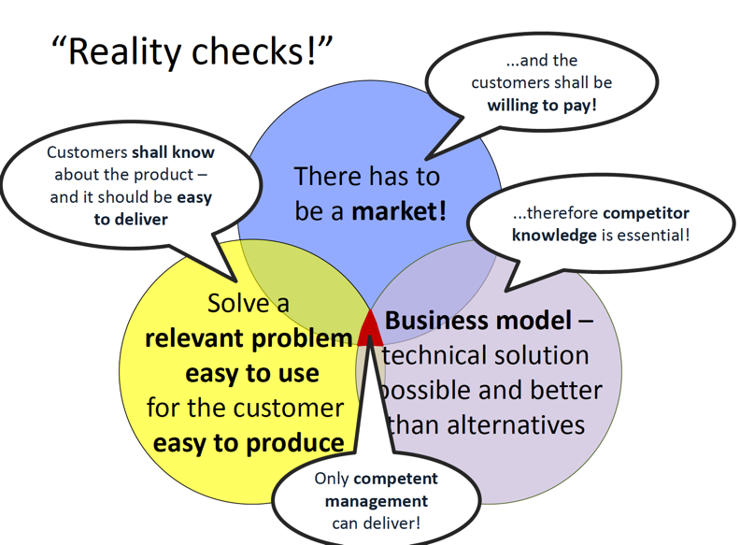

Slide 3

Entrepreneurship
“The capacity and willingness to develop, organize and manage a business venture along with any of its risks in order to make a profit. The most obvious example of entrepreneurship is the starting of new businesses.”
“ An entrepreneur is an intermediary between capital and labor.”
“An entrepreneur is a person who is willing and able to convert an idea or invention into a successful business.”
“An entrepreneur is someone who organizes a business venture and assumes the risk for it.”
“An entrepreneur is a person who has possession of a new enterprise, venture or idea, and assumes significant accountability for the inherent risks.”

Slide 4

VISION

Slide 5

Creativity & Intelligence

Slide 6


Business/ Field
experience

Slide 7
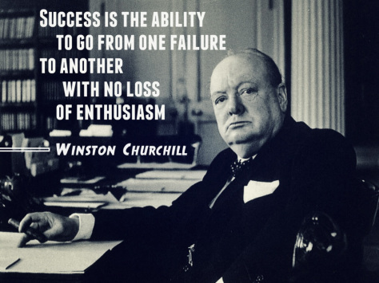

Persistence
& Determination

Slide 8


Charisma &
Persuasion

Slide 9

Decision Maker

Slide 10
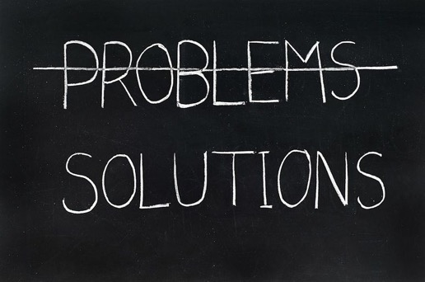
Problem Solver
Do not focus on the problems, find sollutions

Slide 11


Intuition
&

Slide 12

Optimism &
Positive thinking

Slide 13

Passion

Slide 14



Slide 15
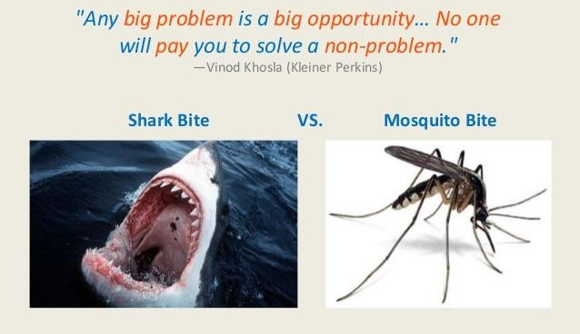

Slide 16
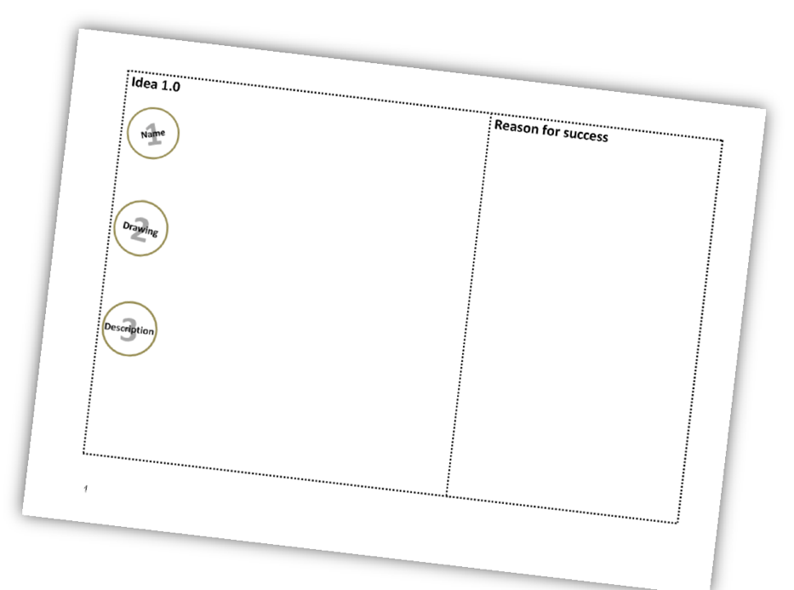

Slide 17
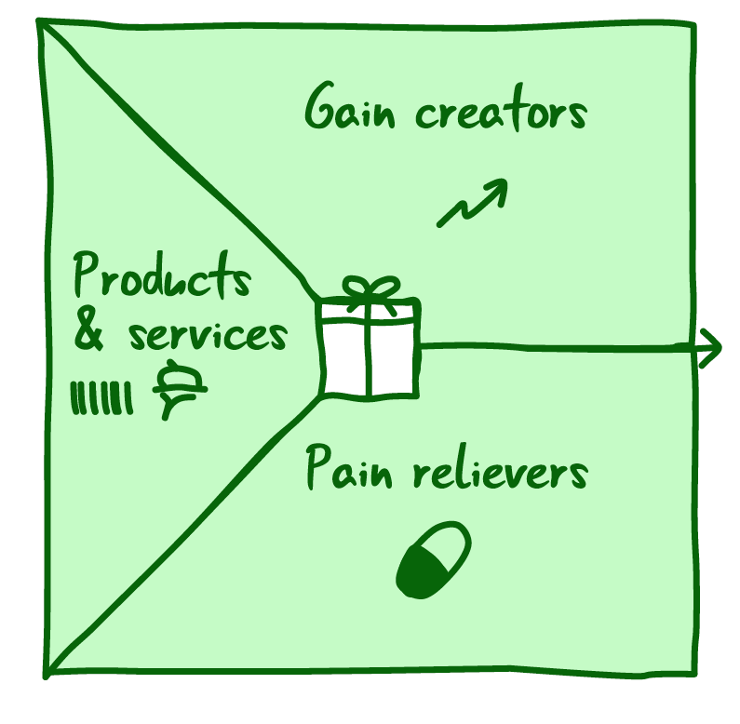
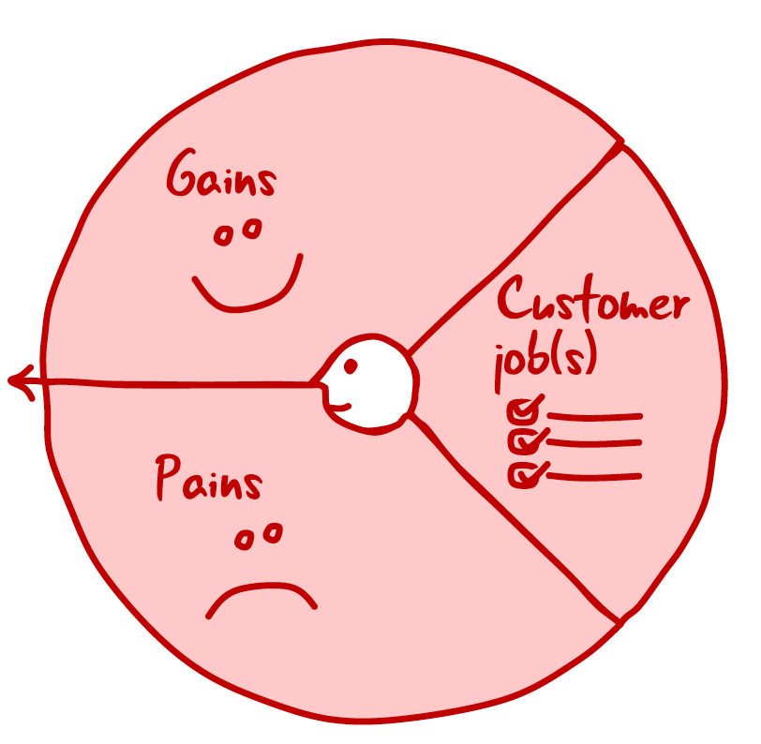
VALUE PROPOSITION CANVAS (see excel file sheet 2 too)
Tool that helps you design your product or services that customers actually want

Slide 18
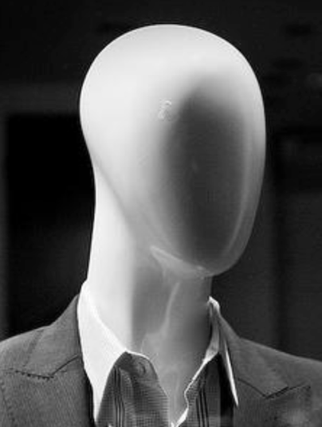
Buyers
Users
Resellers

Slide 19
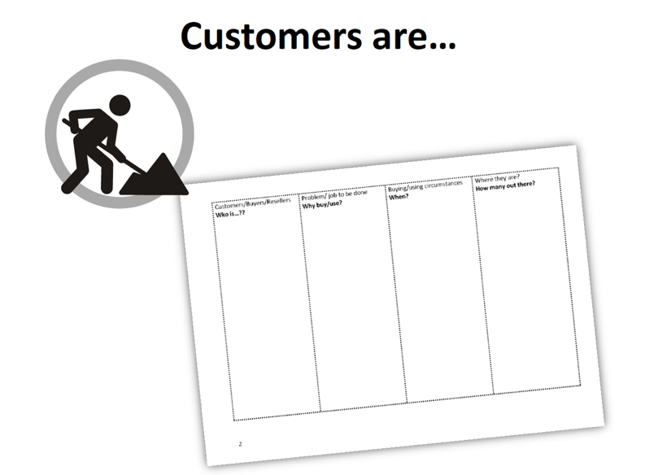

Slide 20
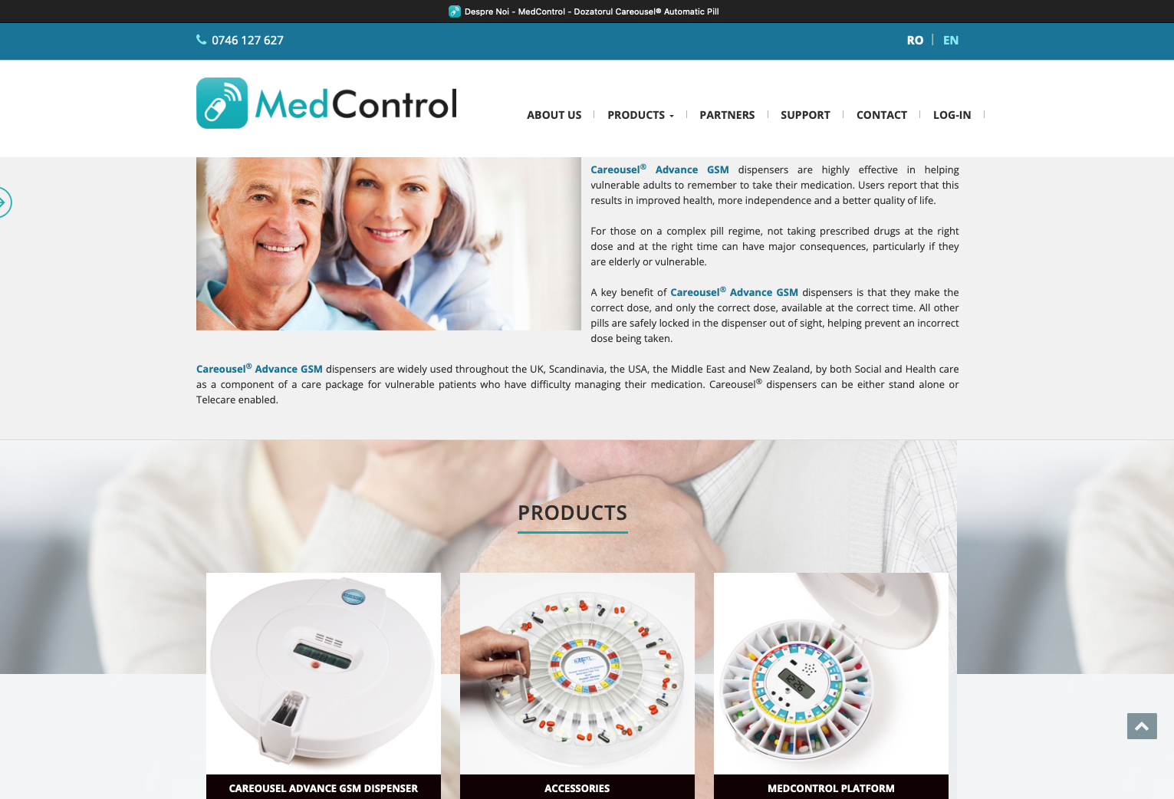

Slide 21
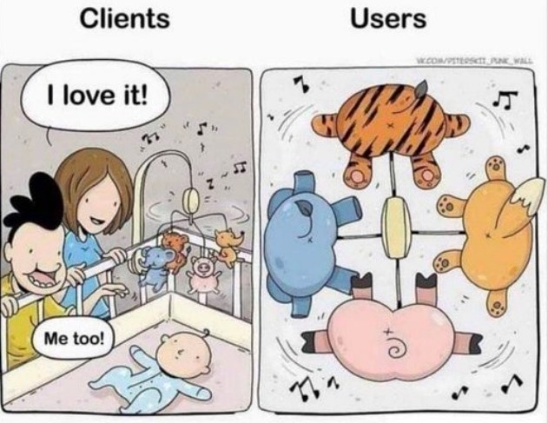

Slide 22

Who is your target customer? Get into the customer's mind, resonate and empathize
How old are they? What is their gender? Where do they live? What do they do for work?
How much money do they make? Is family important to them? What do they do for fun?
What type of TV shows or media do they watch/consume?
What are their hopes, dreams, and aspirations?
What is most important to them? What makes them happy?
What makes them frustrated?

Slide 23
People buy with emotions, then justify with logic
Sell the transformation, not the product
It’s easier to sell an offer that solves a pain than one fulfilling a desire
Your product / service should meet demand, not try to create it
Sales is many times about listening

Slide 24
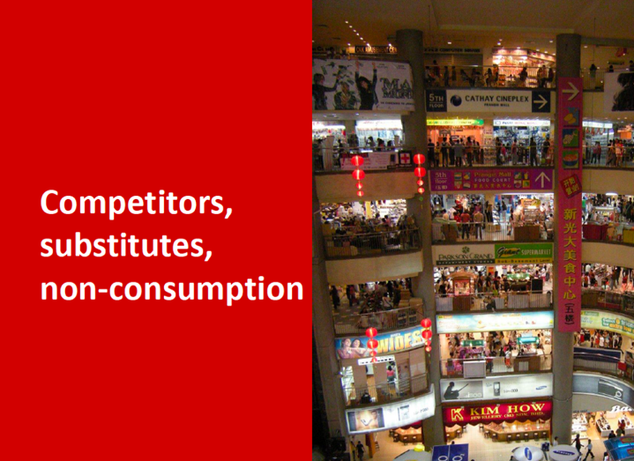
Competition
Offer similar products or services, possibly in the same way or possibly in a different way.
Substitute
Offer products or services different from ours that solve the same problem.
Non-Consumption
The customer solves the problem without resorting to competition or substitutes.
Exemple: Taxi

Slide 25
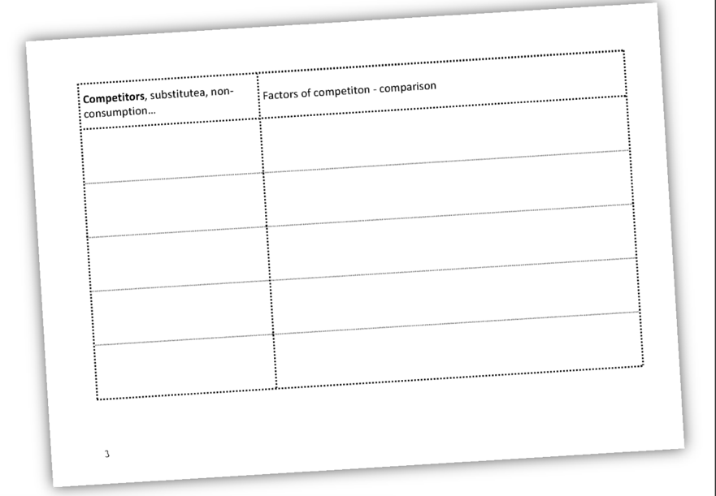

Slide 26
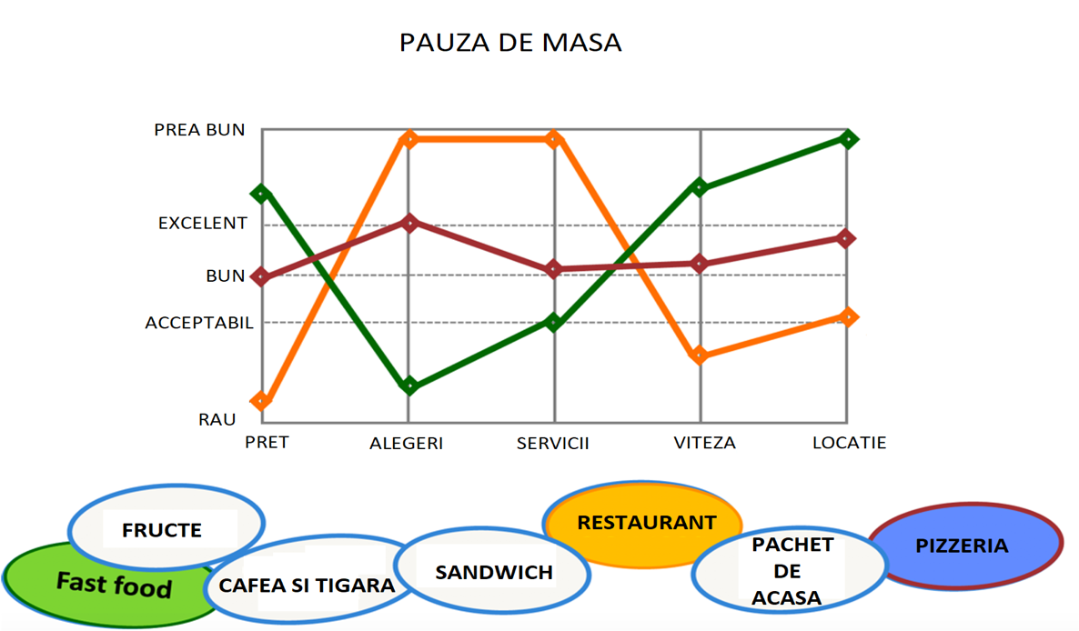

Slide 27
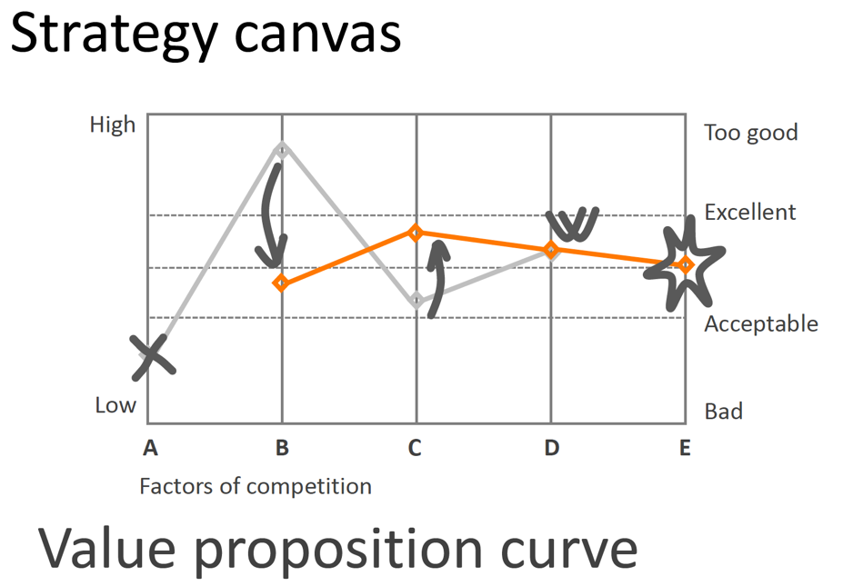

Slide 28
From idea, product and market to the business model
What is a Business Model?
the method by which a company creates, delivers and receives value
answers the question “how?”
A representation of the business plan / organization through which it makes a profit.

Slide 29
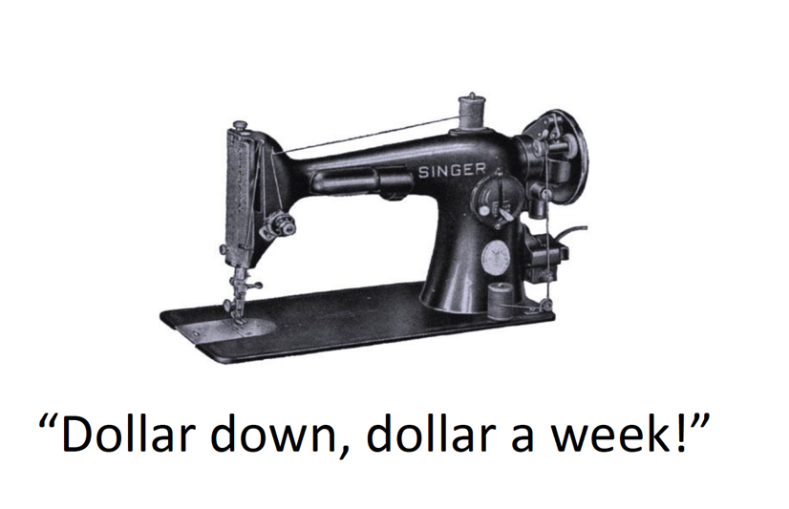
1856
Avg income was $ 500 / year
Sewing machine price: $ 125
Sales in 1857: 3x
Options:
$ down $ a week
Free upgrade for Singer
Buy-back other machines

Slide 30
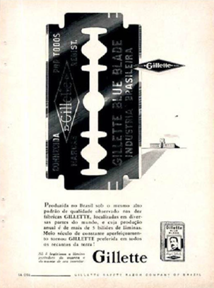

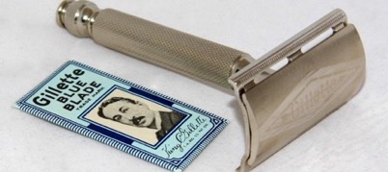
You invest in a base by selling a product at low prices, then sell a related product at high prices to recoup your previous investment.

Slide 31
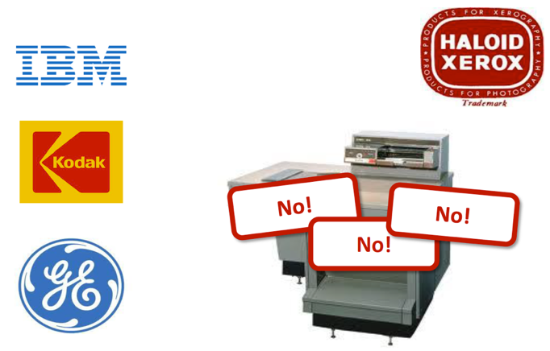
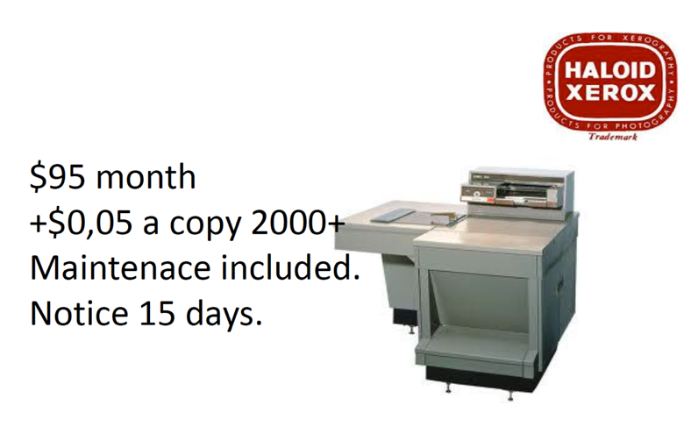

Slide 32
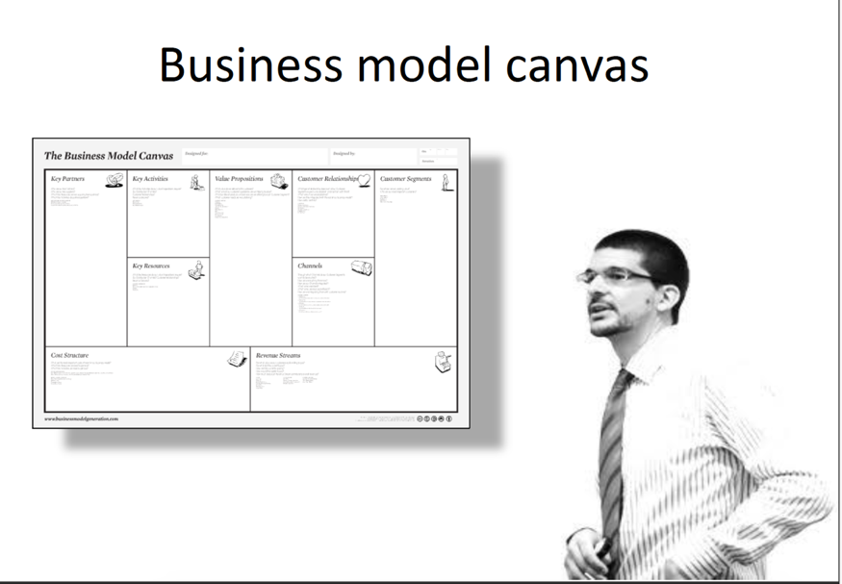

Slide 33
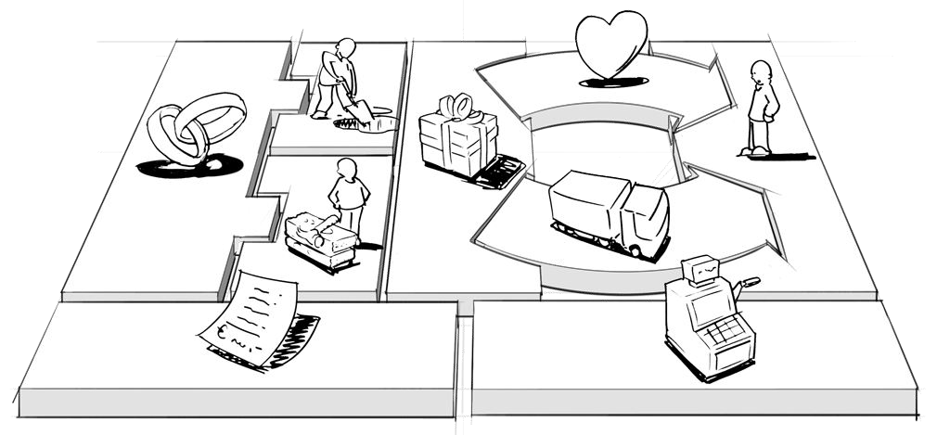
Business Model Canvas

Slide 34
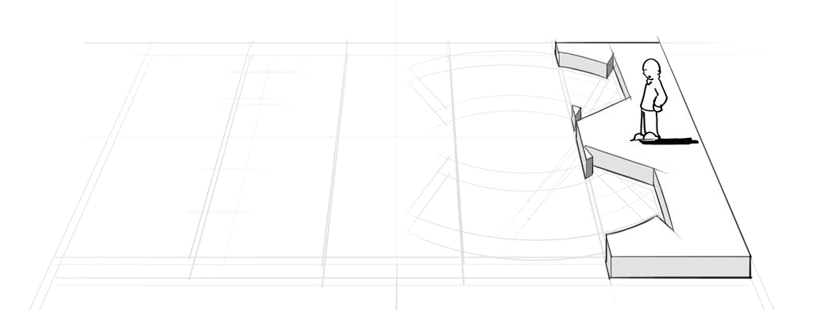
Customer segments
which customers and users are you serving?
An organization serves one or several Customer Segments.

Slide 35
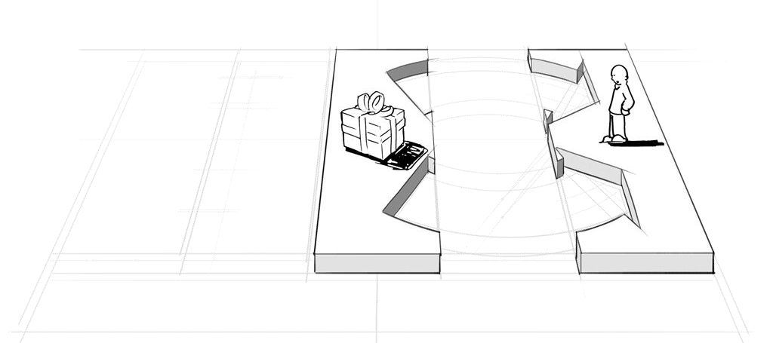
Value proposition
We seek to solve customer problems and satisfy customer needs
with value propositions.

Slide 36
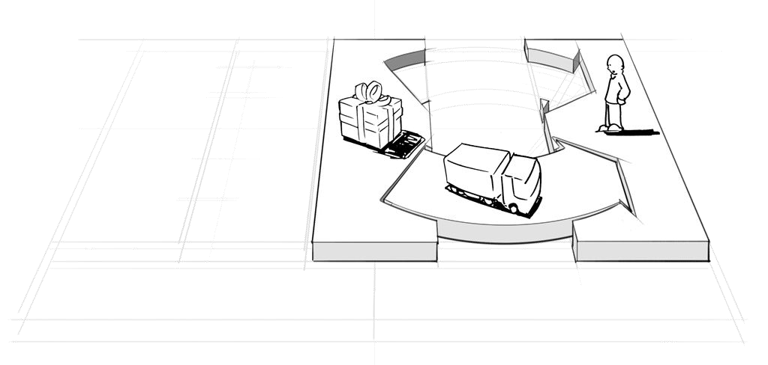
Channels
How do you reach each customer segment?
Value propositions are delivered to customers through
communication, distribution, and sales channels.

Slide 37
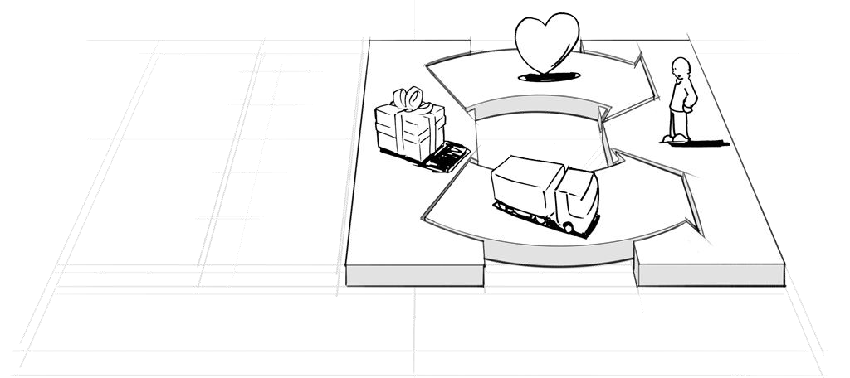
Customer Relationships
What relationships do you establish with each segment?
Customer relationships are established and maintained with each customer segment.

Slide 38
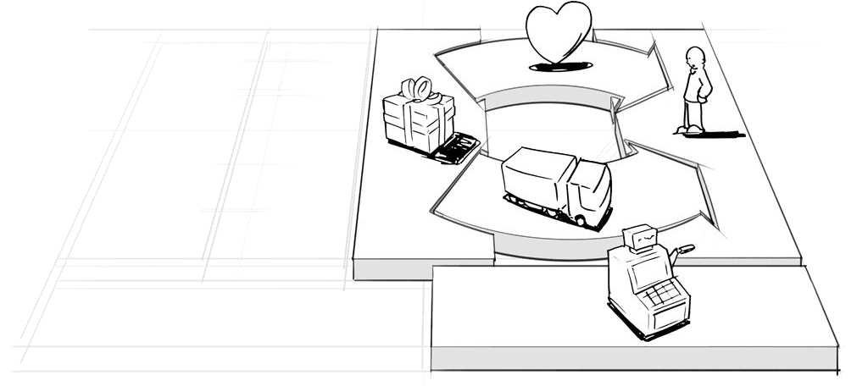
Revenue Streams
What are customers really willing to pay for? How?
Revenue streams result from successfully delivering value propositions to customers.

Slide 39
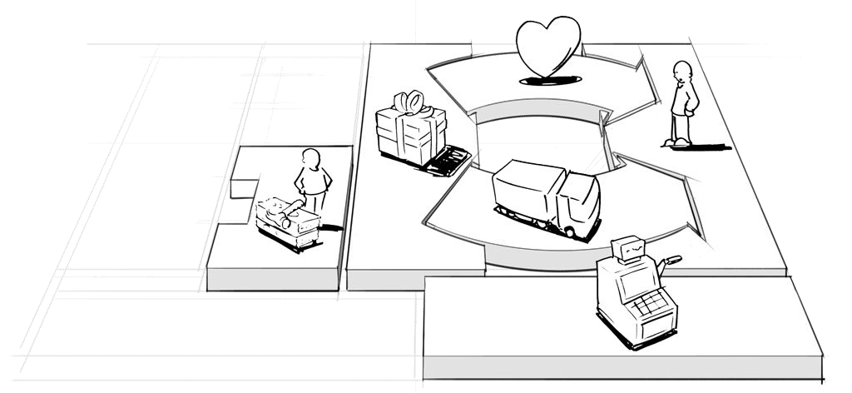
Key Resources
What resources are at the heart of your business model?
Key resources are needed to provide and deliver the elements described above...

Slide 40
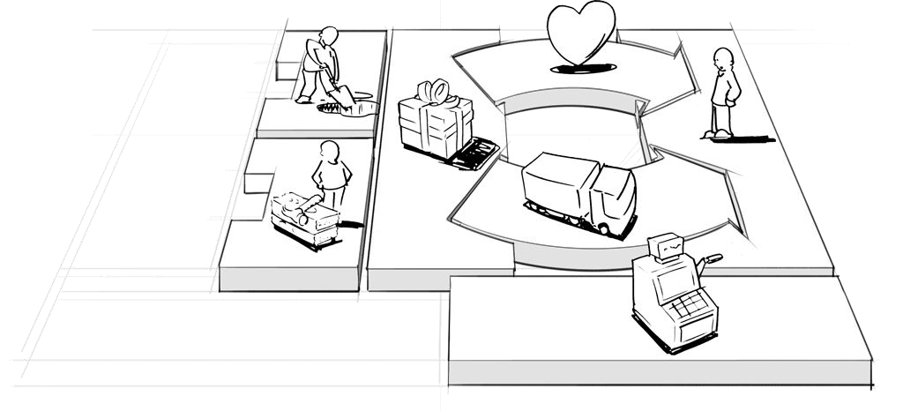
Key Activities
What activities need to be performed in order to perform well in your business?

Slide 41
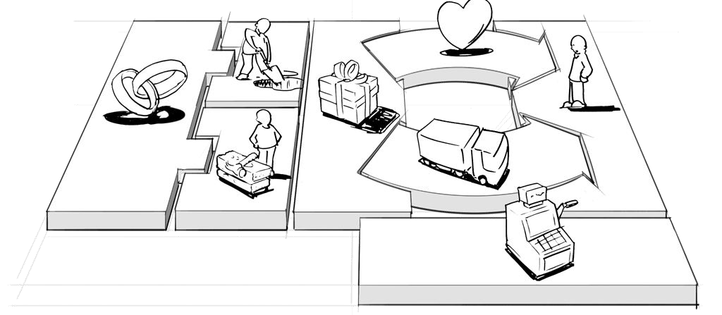
Key Partners
Which partners and suppliers add value to your model?
Some activities are outsourced, and some resources are purchased from outside the company.

Slide 42
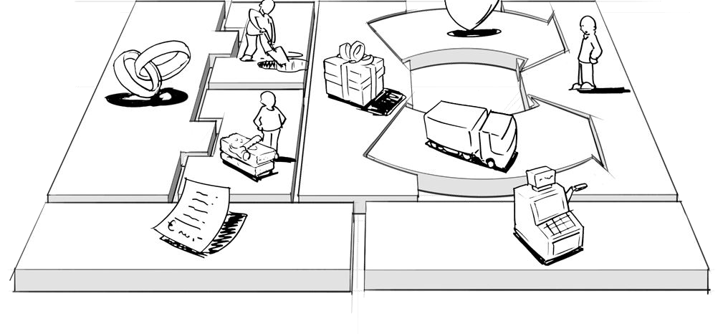
Cost Structure
What is the resulting cost structure?
The business model elements result in the cost structure.

Slide 43
Thank you!

